Slide 1



AWS IoT
Present By Phyo Aung

Slide 2
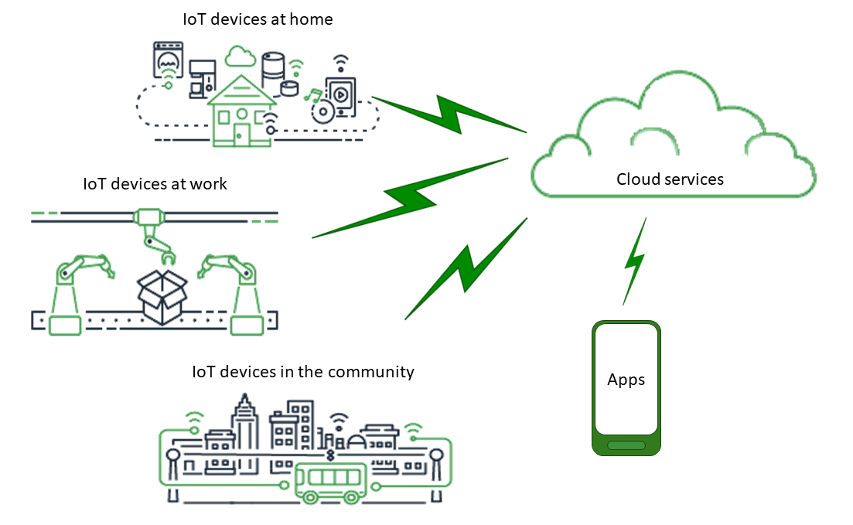

Slide 3
What is AWS IoT?
AWS IoT (Internet of Things) is a cloud-based platform provided by Amazon Web Services that enables devices to connect securely and interact with the cloud. It provides the infrastructure and tools to connect devices to the cloud, securely and at scale. AWS IoT makes it easy for connected devices to interact with cloud applications and other devices.
AWS IoT enables developers to build applications that can interact with and control IoT devices, store and analyze the data generated by those devices, and integrate that data with other AWS services such as Amazon S3, AWS Lambda, and Amazon DynamoDB.
The platform provides features like device management, security and authentication, message routing and data processing, and rules engine to automate actions based on real-time data. It also offers a wide range of SDKs (Software Development Kits) and APIs (Application Programming Interfaces) to make it easy for developers to connect their devices to the cloud and build custom IoT applications.
Overall, AWS IoT provides a scalable, secure, and reliable way to build, deploy, and manage IoT applications and devices.
Notes:
AWS IoT သည် Amazon Web Service ကထောက်ပံ့ထားသော Cloud Based Platform တစ်ခုဖြစ်
AWS IoT သည် IoT Devices တိကို Cloud နဲ့ချိတ်ဆက်ပြီး ကေထိန်းချုပ်ဖို့အတွက်သုံး
AWS IoT သည် IoT Devices ကထုတ်လွှင့်လိုက်တဲ့ Data တိကို Store နဲ့ Analyze လုပ်နိုင်
ယင်းပိုင်လုပ်နိုင်ဖို့အတွက်နဲ့ AWS service တိဖြစ်တဲ့ Amazon S3 , AWS Lambda , Amazon DynamoDB တိကိုသုံး
AWS Platform သည် device management , security and authentication, message routing and data processing , real – time data ကို အခြေခံတဲ့ Automate Action တိကိုထောက်ပံ့ပေး
AWS IoT သည် Developer တိကို SDKs နှင့် API တိကိုသုံးပြီး ကေ သူရို့တိရဲ့ Deviceတိကို Cloud နဲ့ချိတ်ပြီး IoT Application တိတည်ဆောက်ဖို့သုံးနိုင်
Overall အနေနဲ့ AWS IoT သည် IoT Application နဲ့ Devices တိတည်ဆောက်ဖို့ Deploy လုပ်ဖို့နဲ့ Manageလုပ်ဖို့ လုံခြုံ ၊ စိတ်ချရ တဲ့ နည်းလမ်းဖြစ်

Slide 4
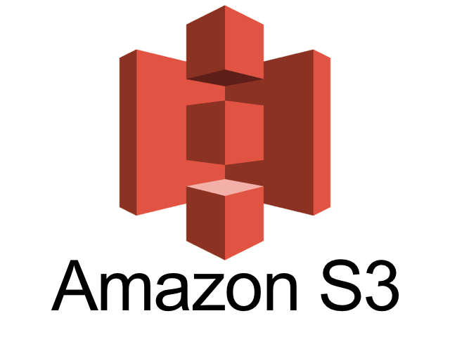

Slide 5
Amazon S3
Amazon S3 (Simple Storage Service) is not a database. It is a cloud-based object storage service provided by Amazon Web Services (AWS) that allows you to store and retrieve large amounts of data from anywhere on the internet. While S3 is often used to store data for databases, it is not a database itself. Instead, S3 is designed to provide highly scalable, durable, and secure storage for a wide range of data types, including images, videos, audio files, and documents.
Notes:
Amazon S3 သည် cloud-based object storage service တစ်ခုဖြစ်
Amazon S3 သည်မည်သည့်နေရာကမဆို internet ပေါ်မာဟိတဲ့Dataတိကိုသိုလှောင်ဖို့နဲ့ဆွဲထုတ်ဖို့အတွက်သုံးနိုင်ရေ
Amazon S3 သည် Database များကိုသိုလှောင်ဖို့အတွက်သုံးနိုင်သော်လည်း ၎င်းသည်Databaseမဟုတ်ပါ
Amazon S3 သည် images,videos ,audio file , documents တိကိုသိုလှောင်နိုင်

Slide 6
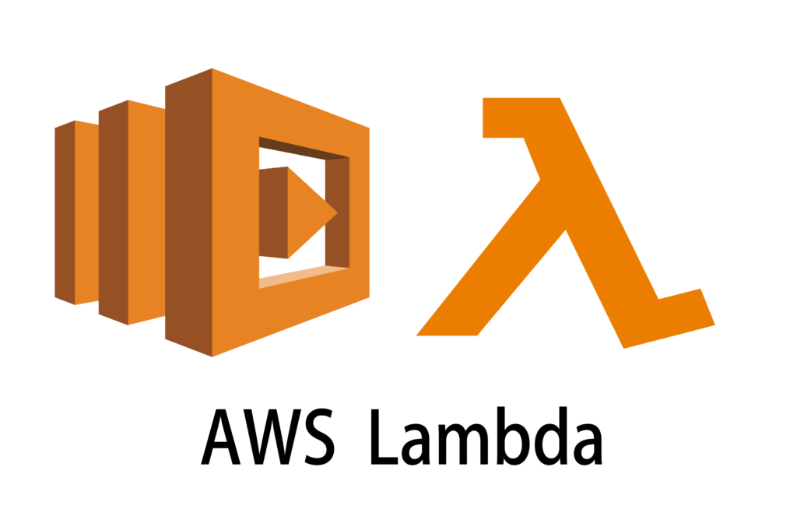

Slide 7
AWS Lambda
AWS Lambda is not a database. It is a serverless computing service provided by Amazon Web Services (AWS) that allows you to run code without provisioning or managing servers. You can use Lambda to run your code in response to events such as changes to data in Amazon S3, DynamoDB, or other AWS services, or to create APIs, web applications, or chatbots.
While Lambda can interact with databases such as Amazon DynamoDB, Amazon Aurora, or Amazon RDS, it is not a database itself. Instead, Lambda is designed to execute code in response to events and scale automatically to handle a large volume of requests without requiring you to provision or manage servers.
Notes:
AWS Lambda သည် Serverless Computing Service တစ်ခုဖြစ်
AWS Lambda သည် Server ကို Manage မလုပ်ဘဲ code တိကို Cloud ပေါ်မာ Run နိုင်
Database အတွင်းသို့ Record အသစ်ထည့် ၊ S3 ထဲသို့ File Upload လုပ်တဲ့အချိန်တိမာ Noti ပို့ဖို့အတွက် Lambda ကိုသုံး
Lanbda ကို Mobile ph တိမာ user တိကို Authenticate လုပ်ဖို့ Verify လုပ်ဖို့နဲ့ Mobile app တိအတွက် Noti ပို့ဖို့အတွက်သုံး
Lambda ကို Facebook Messenger , Slack , Twilio ရို့ပိုင် Chatbox တိမာ Auto Reply အတွက်သုံး

Slide 8
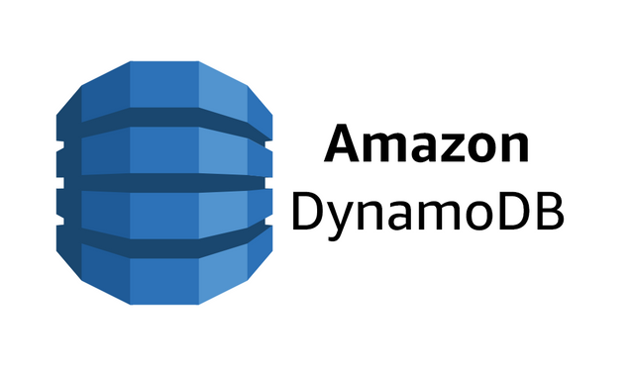

Slide 9
Amazon DynamoDB
Amazon DynamoDB is a fully managed NoSQL database service provided by Amazon Web Services (AWS). It is designed to provide scalable, low-latency, and high-performance access to structured and semi-structured data.
DynamoDB is a document-oriented database that stores data in tables, which consist of items and attributes. DynamoDB supports a wide range of data types, including strings, numbers, binary data, lists, and maps.
One of the key features of DynamoDB is its scalability and performance. It can handle large amounts of data and traffic, and automatically scales up or down to meet your needs. It also provides low-latency access to data, with typical response times measured in single-digit milliseconds.
DynamoDB also provides flexible data modeling, with support for both document and key-value data models, and offers advanced features such as global secondary indexes, transactions, and on-demand backup and restore.
Notes:
Low - Latency = Short wait time
Relational Database အနေနဲ့ Amazon RDS(Relational Database Service) ဟိရေ

Slide 10
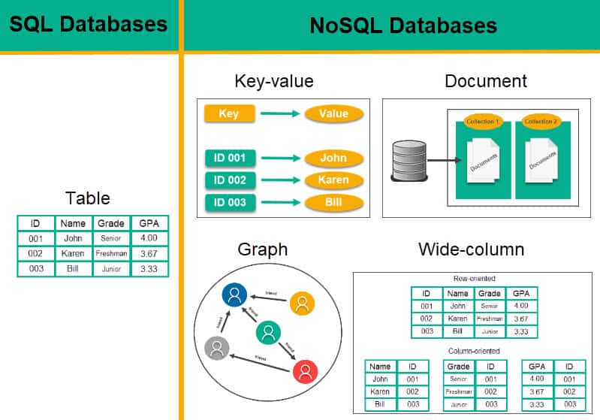

Slide 11
Uses of AWS IoT
AWS IoT can be used in a variety of applications and industries that require real-time data processing, analysis, and communication between connected devices. Here are some examples:
Smart Homes: AWS IoT can be used to create smart home solutions that allow homeowners to control and monitor devices such as lights, thermostats, and security systems from their mobile devices.
Industrial IoT: AWS IoT can be used in industrial settings to connect and monitor sensors, machines, and equipment to optimize operational efficiency and improve maintenance.
Healthcare: AWS IoT can be used in healthcare to collect and analyze data from medical devices, wearables, and sensors to monitor patients' health and track their medication adherence.
Agriculture: AWS IoT can be used in agriculture to collect data from sensors on crops, soil moisture, and weather conditions to optimize irrigation and fertilization.
Transportation: AWS IoT can be used in transportation to monitor and optimize the performance of vehicles, track shipments, and analyze traffic patterns to improve logistics and reduce costs.
These are just a few examples of the many use cases for AWS IoT. Its flexibility and scalability make it suitable for a wide range of applications across industries.
Notes:
AWS IoT ကို Real Time Data တိကိုလိုအပ်တဲ့ Application တိနဲ့ စက်ရုံတိမာသုံး

Slide 12
Which Language use AWS IoT?
AWS IoT supports several programming languages for developing applications and connecting devices to the IoT platform. Here are some of the supported programming languages:
JavaScript
Python
C
C++
Java
Node.js
Arduino
Other .NET Framework Languages
You can use any of these languages to develop IoT applications and connect them to AWS IoT using the appropriate SDKs and APIs provided by AWS.

